Slide 1
The Strengths and Weaknesses of Extreme Programming
A mini-presentation by William Matheson
An Extreme Programmer http://blog.technicalmanagementinstitute.com/photos/uncategorized/2008/07/11/extremeprogrammercropped800x600.jpg

Slide 2
Strengths of XP
Eliminates Big Design Up Front
Codes most important features first
Responsive to change
Pair Programming: Creativity and focus

Slide 3
Eliminates Big Design Up Front
Dilbert by Scott Adams :: November 26th, 2007 http://dilbert.com/strips/comic/2007-11-26/

Slide 4
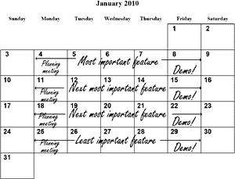
Codes most important features first
Agile Process: “Manage your goals instead of activities”
http://www.agile-process.org/byfeature.html

Slide 5
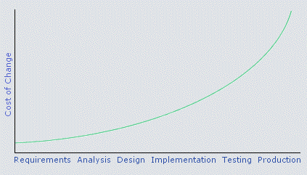
Responsive to change
The cost of change rising exponentially over time, from Extreme Programming Explained by Kent Beck
http://www.softwarereality.com/lifecycle/xp/four_values.jsp

Slide 6
Pair Programming: Creativity and focus
Dilbert by Scott Adams :: January 11th, 2003 http://dilbert.com/strips/comic/2003-01-11/

Slide 7
Weaknesses of XP
Eliminates Big Design Up Front
Good design can pay for itself
Requires a lot of overhead
Order of importance is subjective and can still be addressed by up-front design
Emphasizes teamwork, communication, and prioritizing, but this is done to address the burden of “dynamic” environments
Each rule of XP works only when supported by another rule

Slide 8
Eliminates Big Design Up Front
Dilbert by Scott Adams :: March 21st, 2003
http://dilbert.com/strips/comic/2003-03-21/

Slide 9
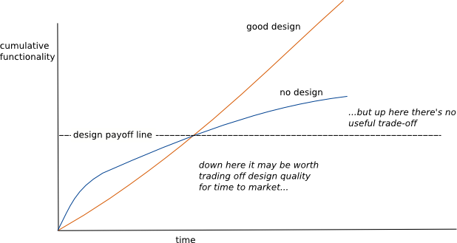
Good design can pay for itself
Functionality versus time pseudo-graph by Martin Fowler
http://martinfowler.com/bliki/DesignStaminaHypothesis.html

Slide 10
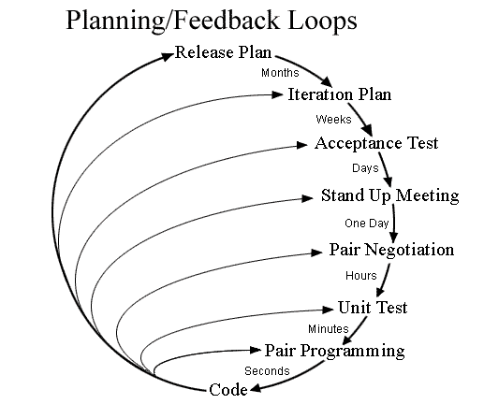
Requires a lot of overhead
Extreme Programming Feedback Loops by Don Wells
http://en.wikipedia.org/wiki/File:XP-feedback.gif

Slide 11
Order of importance is subjective and can still be addressed by up-front design
Dilbert by Scott Adams :: January 10th, 2003
http://dilbert.com/strips/comic/2003-01-10/

Slide 12
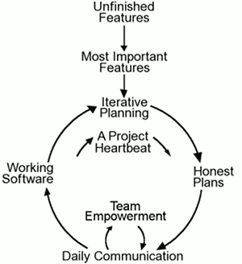
Emphasizes teamwork, communication, and prioritizing, but this is done to address the burden of “dynamic” environments
“Agile” flowchart by Don Wells
http://www.agile-process.org/iterative.html

Slide 13
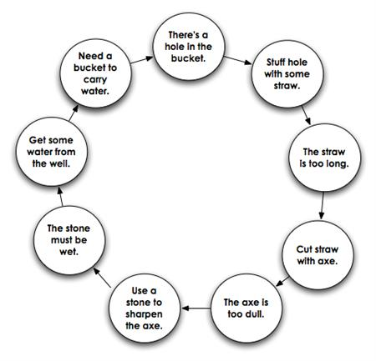
Each rule of XP works only when supported by another rule
Fixing a hole in a bucket, by Henry and Liza
http://www.fashion-dress-pictures.com/theres-a-hole-in-the-bucket-dear/

Slide 14
Where to Go from Here
Extreme Programming: A Gentle Introduction
http://www.extremeprogramming.org
Extreme Programming (Refactored) (A skeptical viewpoint)
http://www.softwarereality.com/lifecycle/xp/index.jsp
http://bit.ly/xp-refactored (shortened URL)
Extreme Programming Wikipedia Article
http://en.wikipedia.org/wiki/Extreme_programming

