Slide 1
Choosing a Display
A brief talk by William Matheson

Slide 2
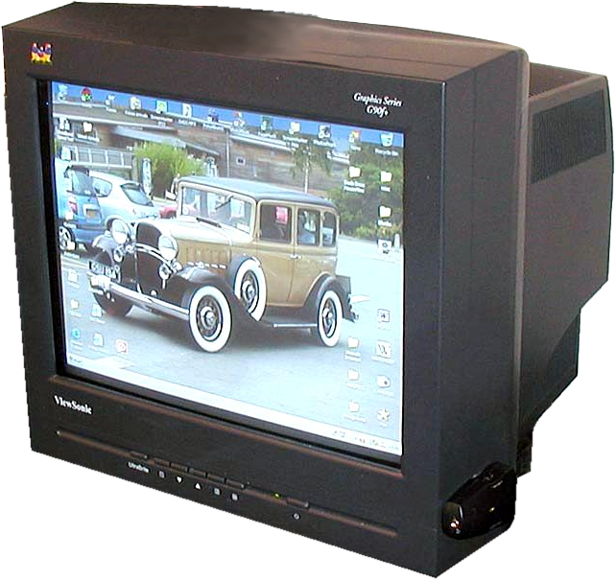
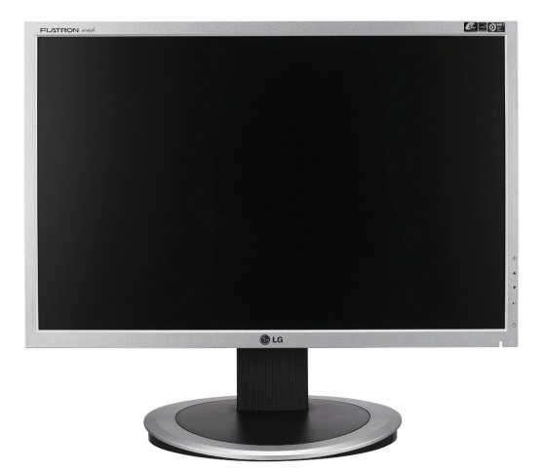
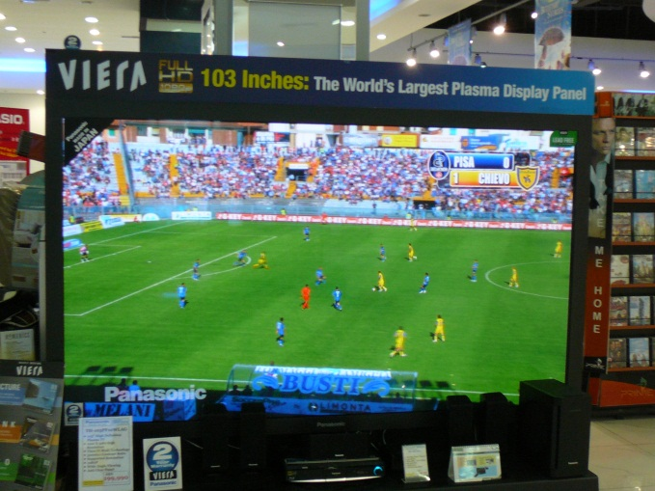
Three Common Technologies
CRT
LCD
Plasma
(click on images to visit sources)

Slide 3
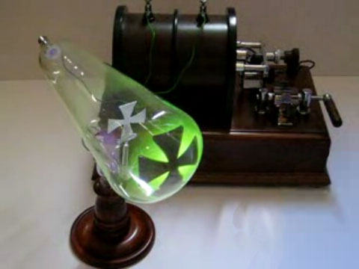
CRT: Cathode Ray Tube
Cathode rays are streams of electrons observed in vacuum tubes:
Cathode rays casting a shadow on the wall of a Crookes tube

Slide 4
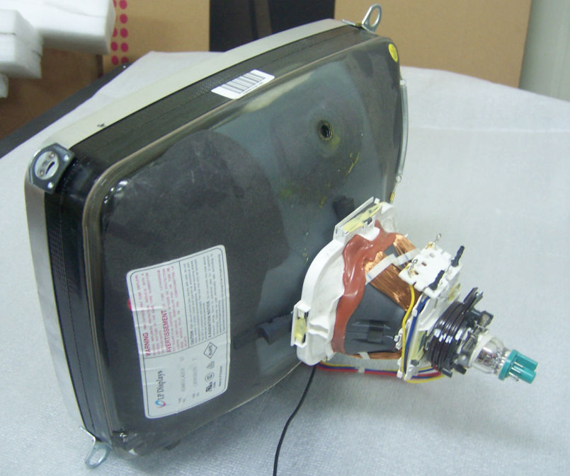
CRT: Cathode Ray Tube
To make a display, we need an electron gun and an evacuated picture tube:

Slide 5
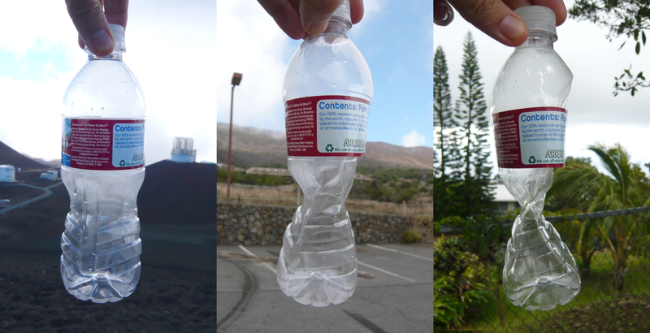
CRT: Cathode Ray Tube
We need a strong material to hold a vacuum against our atmosphere!
Mauna Kea, Hawaii: Plastic bottle sealed at 14,000 feet (left) taken down to 1,000 feet (right).

Slide 6
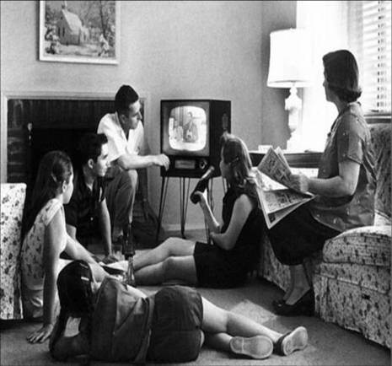
CRTs: Advantages
Very wide viewing angle (close to 180°):

Slide 7
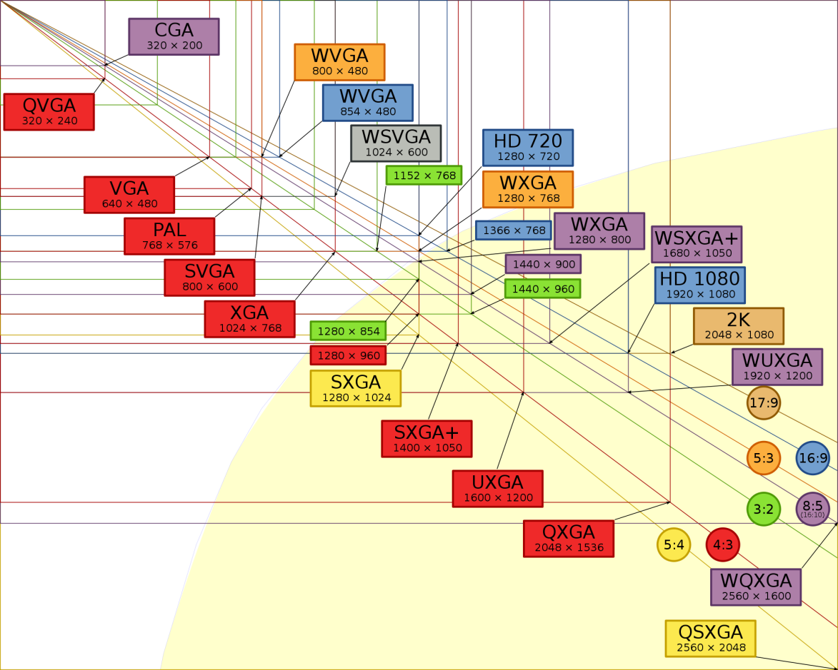
CRTs: Advantages
Every resolution is optimally displayed.

Slide 8
CRTs: Advantages
Ideal for displaying low-resolution content.
Lowest-possible input lag, fast response time.

Slide 9
CRTs: Disadvantages
Heavy

Slide 10
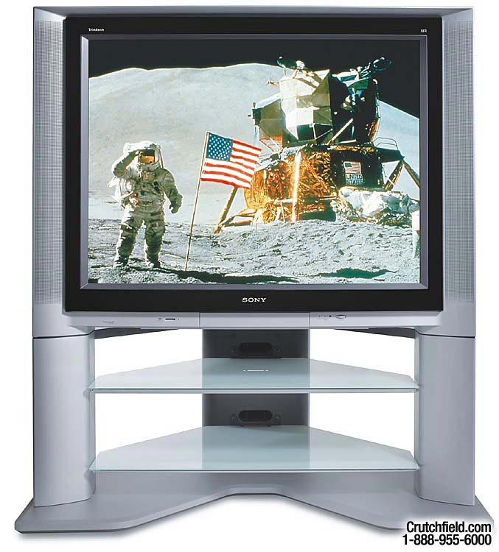
CRTs: Disadvantages
Expensive
Sony KV-40XBR800: 40 inches, 304 pounds, 2,999 dollars

Slide 11
LCD: Liquid Crystal Display
Use light modulating properties of liquid crystals (being of a state of matter between conventional liquid and solid crystal)

Slide 12
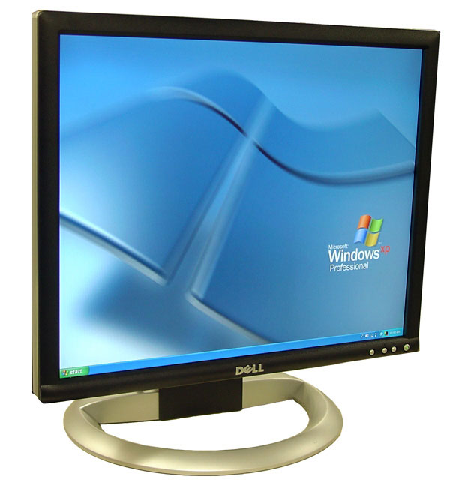
LCDs: Advantages
Compact
Light
Cheap

Slide 13
LCDs: Disadvantages
Only operate well at one (native) resolution

Slide 14
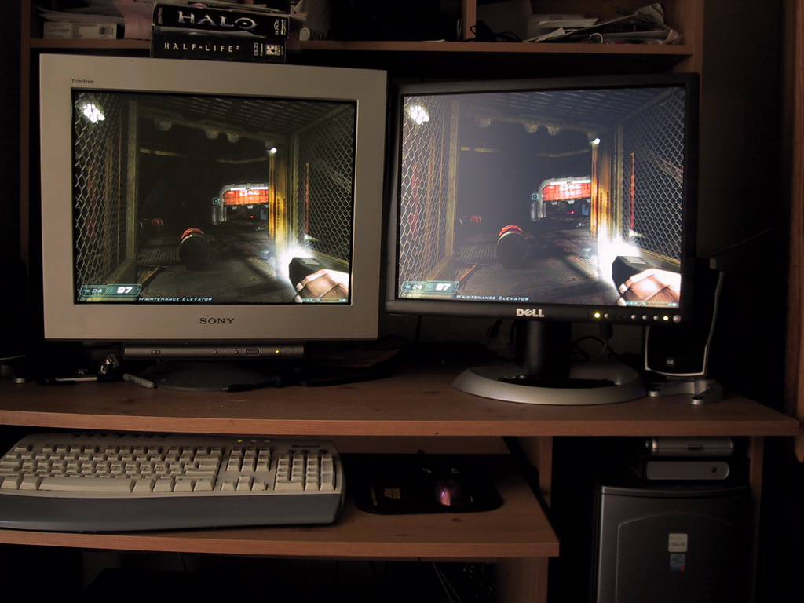
LCDs: Disadvantages
Require backlighting

Slide 15
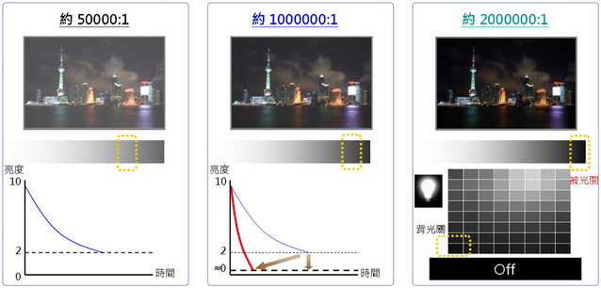
LED-backlit LCDs
New LCDs are often backlit by LEDs*, allowing for finer control of backlighting:
Single rear backlight
Edge-positioned backlights
Array of LED backlights
* - Light Emitting Diode. Seen increasingly in things like bus destination signs (the individual LEDs make up a dot matrix)
and automotive headlamps (the LEDs replace conventional light bulbs).

Slide 16
Contrast Ratio
Difference between brightest and darkest light level the display can show at once (static) or ever (dynamic)
The bigger the better
Static is harder to achieve than dynamic
Measurement differs among manufacturers, so only use it to compare among a single model line

Slide 17
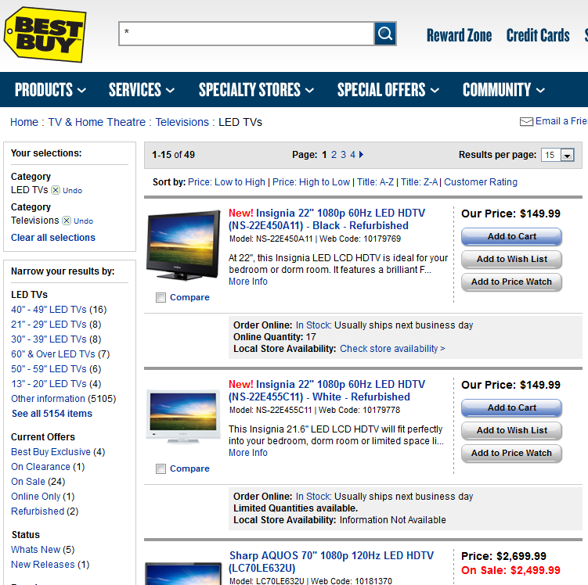
LED-backlit LCDs
Beware: LED-backlit LCDs are often marketed as “LED TVs”:

Slide 18
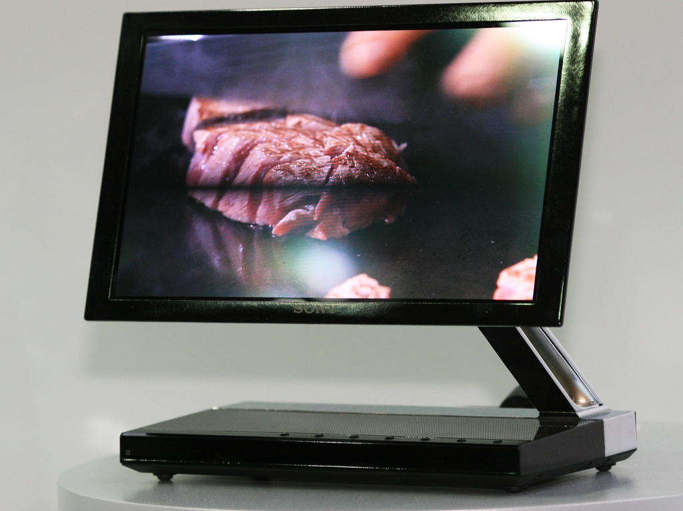
An actual LED TV
Sony XEL-1: 11 inch diagonal, 3 millimeter thickness, 2,499 dollar expense

Slide 19
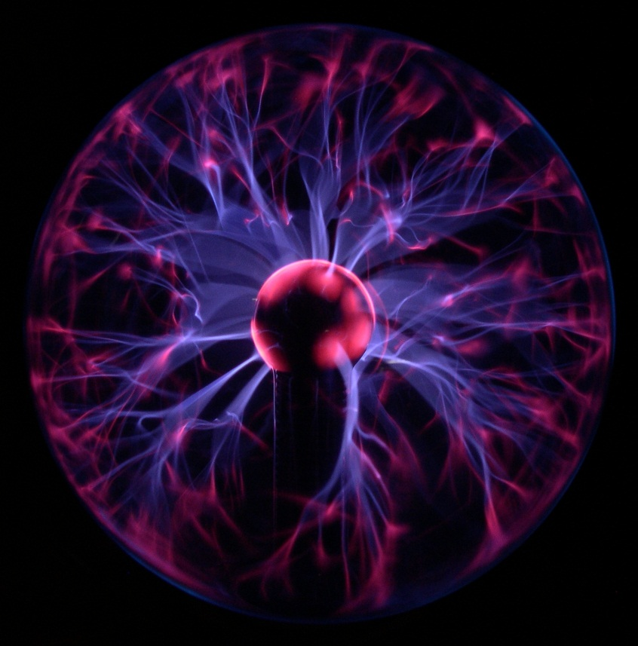
Plasma
Uses cells containing electrically charged ionized gases

Slide 20
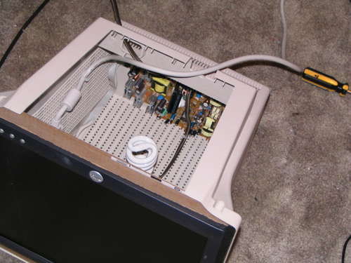
Plasma: Advantages
Obviates backlighting
This industrious user is working around a broken LCD backlight by mounting the liquid crystal panel onto the case of a disused CRT monitor and installing a fluorescent lightbulb.

Slide 21
Plasma: Advantages
Fast response time, less motion blur
Sharper
Blurrier-er

Slide 22
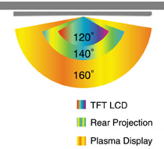
Plasma: Advantages
Wide viewing angle:

Slide 23
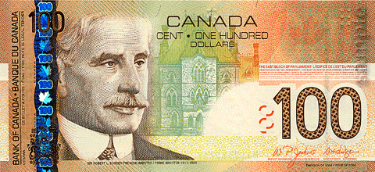
Plasma: Disadvantages
Expensive; seldom offered in sizes smaller than 37 inches
… but the initial outlay for the technology scales well: At very large sizes, plasmas are cheaper than comparatively sized LED-backlit LCDs (but still more expensive than conventional LCDs).

Slide 24
Plasma: Disadvantages
Doesn’t work well at high altitudes because of the pressure differential

Slide 25
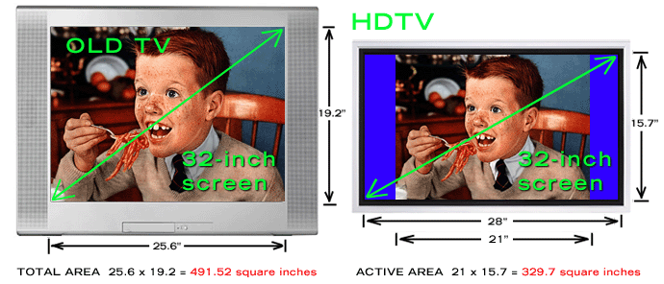
Screen Size
Displays are typically sold by their diagonal
When changing the ratio of the display, the relative length of the diagonal also changes:

Slide 26
Screen Size

Slide 27
Screen Size
9² + 12² = h_{12:9}² = 225
h_{12:9} = $\sqrt{225}$ = 15
9² + 16² = h_{16:9}² = 337
h_{16:9} = $\sqrt{337}$
$\frac{\text{h}\text{16:9}}{\text{h}\text{12:9}}$ = $\frac{\sqrt{337}}{15}$ ≈ 1.2238…
To find the diagonal of the appropriate 16:9 replacement for a 4:3 display, multiply the diagonal of the 4:3 display by 1.22.

Slide 28
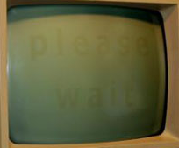
Screen Burn-in
Though the mechanics differ among them, this anomaly affects all display types:
CRT
LCD
Plasma

Slide 29
Screen Burn-in
To avoid burn-in, avoid long-persisting pixels (prompts, sign-in screens, watermarks, channel indicators, etc..)
At Saint Mary’s in the middle of the last decade, this login screen was persistent enough
that it burned itself into many of the workstation LCDs.

Slide 30
Thank You

